Slide 1
The Decline of Quantitative History

Slide 2
American Historical Review
Comparative Studies in Society and History
Journal of American History
Journal of Modern History
Past & Present
Statistical tables and graphs per 1000 pages of articles: five top-cited history journals, 1945-2009

Slide 3
Statistical tables and graphs per 1000 pages of articles: five top-cited history journals, 1945-2009
“By the 1980s, the historian will be a programmer or he will be nothing.”
--Le Roy Ladurie, 1968

Slide 4
Statistical tables and graphs per 1000 pages of articles: five top-cited history journals, 1945-2009
“Narrative, with its hidden assumptions, buried causal structures, and lack of falsifiability is too obviously an inferior good to run QUASSH out of the marketplace.”
--Morgan Kousser, 1984

Slide 5
Why did the enterprise collapse so completely and dramatically?

Slide 6
Statistical tables and graphs per 1000 pages of articles: five top-cited history journals, 1945-2009
1976: Ruggles chooses grad school in history

Slide 7
Statistical tables and graphs per 1000 pages of articles: five top-cited history journals, 1945-2009
1979: Lawrence Stone, “Revival of Narrative”

Slide 8
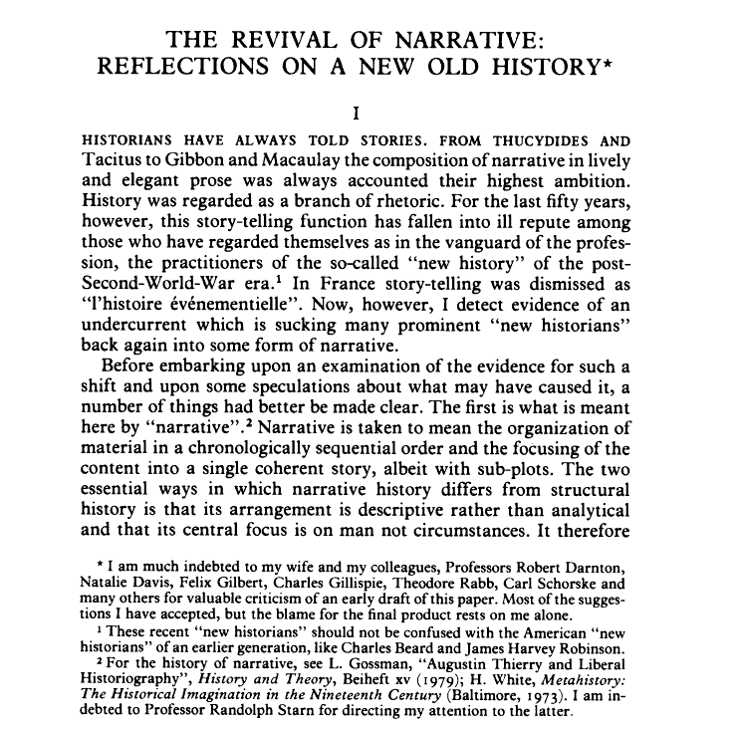

Slide 9
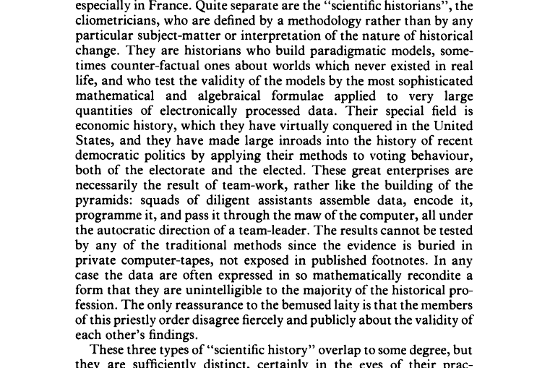

Slide 10
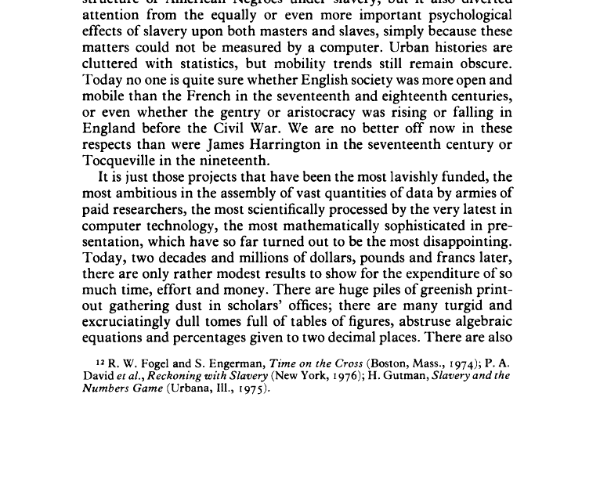

Slide 11
Statistical tables and graphs per 1000 pages of articles: five top-cited history journals, 1945-2009
1979: Lawrence Stone, “Revival of Narrative”
1979: Tony Judt, “Clown in Regal Purple”

Slide 12
Tony Judt, “A Clown in Regal Purple” History Workshop Journal 7(1979), 66-94
“. . .social history is suffering a severe case of pollution. The subject has become a gathering place for the unscholarly, for historians bereft of ideas and subtlety . . . Complete epistemological bankruptcy . . . ludicrous . . . fundamentally unscholarly . . . mediocrity . . twaddle . . . stupid, or historically illiterate . . . shoddy work . . . the slow strangulation of social history”

Slide 13
Statistical tables and graphs per 1000 pages of articles: five top-cited history journals, 1945-2009
Bridenbaugh delivers “Bitch Goddess” address

Slide 14
The shrine of the Bitch-goddess
Carl Bridenbaugh's 1962 presidential address to the American Historical Association:
“The finest historians will not succumb to the dehumanizing methods of social sciences . . .
Nor will the historian worship at the shrine of that Bitch-goddess, QUANTIFICATION. History offers radically different values and methods. It concerns itself with the ‘mutable, rank-scented many,’ but it fails if it does not show them as individuals . . .”

Slide 15
Statistical tables and graphs per 1000 pages of articles: five top-cited history journals, 1945-2009
T/C Backlash
T/C
PSHP

Slide 16
How do trends in in social science history compare across top journals of History, Economics, Sociology, and Demography?

Slide 20
Fogel wins Nobel (1993)
T/C

Slide 23
Conclusion: we are in a golden age of quantitative social science history.
(just not among historians)

Slide 24
Future prospects
An unprecedented quantity of large-scale historical data collection projects are underway or will soon be launched in many countries
We have seen that data availability stimulates research, so the boom should continue or accelerate in the next couple of decades
There is no sign, however, of any revival of quantification among historians

Slide 25
Why do we care?
As long as research is thriving, why should we care if it is concentrated among economists and demographers?
Because:
  Historians have a lot to offer QUASSH
  QUASSH has a lot to offer the field of history

Slide 26
History has assets to offer QUASSH (1)
Historians have a strong archival tradition, so gathering, disseminating, and preserving information is highly valued (e.g., unlike economics)
Historians who are immersed in the literature and archives of a particular period may be able to interpret data better than social scientists who often have little background in the period they are studying
The low prestige of data collection in economics means that they do not always do it carefully (there are exceptions, of course—some of my best friends . . .)
Historians are best-qualified custodians and developers of historical data

Slide 27
History has assets to offer QUASSH (2)
Historians are less likely than other social scientists to assume that people’s goals and values were the same then as they are now
Many economists and sociologists focus on assessing how changing circumstances have led to changing behavior
Historians are more likely to regard changes in people’s goals and values as an appropriate object of study

Slide 28
QUASSH has a lot to offer history (1)
Historians have a vital interest in the production of the highest quality historical statistics
Even when they don’t admit it, virtually all historians implicitly or explicitly rely on quantitative estimates—including cultural, political, diplomatic, and labor historians
We shouldn’t abandon our influence over this critical part of historical investigation
If we abandon the field, we lose control

Slide 29
QUASSH has a lot to offer history (2)
QUASSH is virtually the only historical specialization in which it is possible to raise very large sums of research money. I see no reason that we should entirely cede this asset to economists and sociologists.

